Slide 1
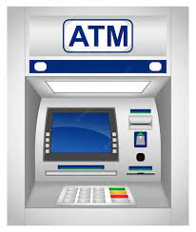
Semester Project
ATM
Automatic Teller Machine
By M. Mubeen Channa
Assigned By Sir Noor Nabi

Slide 2

About ATM
What is ATM?
Why We Need To Use ATM?
Automated Teller Machine (ATM) is a type of computer that allows you to complete bank transactions without Go in bank.
The ability to access our account 24/7 at multiple locations.
It is easy to carry a slim card as opposed to a wad of cash book.

Slide 3
About Our Project
Data Used:
Libraries.
Functions.
Conditional Statement.
Goto statements.
Control Statements.

Slide 4
Libraries
Iostream
Fstream
It is input output library
It defines simple input and output
Such as cin, cout etc.
This header file mainly describes the file stream it is used to handle our data being read from file as input or data being written into the file as output.

Slide 5
Libraries
Conio.h
Unistd.h
We have used it to it’s getch() function to hold our screen till the user input any key.
We have used it to make our program delay some time.
It is used for hold the screen
Windows.h
We have used it for clear screen.

Slide 6
Conditional Statements
Two Types of Conditions Used In Project
1. Switch Case Condition
2. If-else Condition
Control Statement
Only Control Statement Used In Project
1. For Loop

Slide 7
Features
Features Used In Our Project
Balance Inquiry
Cash Withdraw
Deposit
Transfer Money
Change Pin
Transaction History

Slide 8
Flowchart
Lets Draw FLowchart Of Project

Slide 9
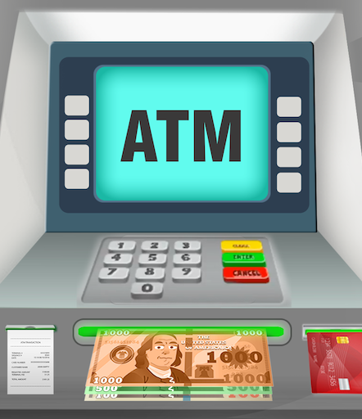
Thank You.

